Slide 1
Faith In Action – Faith Portfolio
S.K. Bro. Joseph Remedios, FDD, PGK, PFN
Faith Director
Faith
^{IN} Action
Notes:
Good Morning Brothers.
Faith in Action? Yes, it is embodied in our Principles of Charity Unity and Fraternity, these principles are the sublime mystery in which all of you have thus far learned comes together in the splendid tapestry of Faith.
When Fr. McGivney founded this organization of Catholic men, he wanted it to be in every parish.
For protection of our Priests for their mission and Vocations
For men to defend their faith, to support the parish and to help families to live together even in the event of the passing away of the member
What powerful words…with this, let me lead you into the programs under this category which are all designed to help us to believe and practice in the love of these truths and we will be guided to an eternity of happiness.

Slide 2
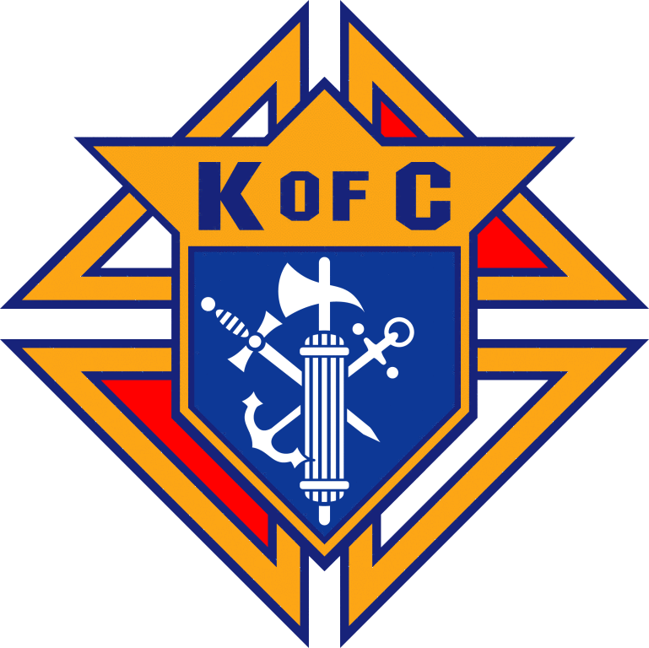
Portfolio Overview
RSVP
Into the Breach
Building the Domestic Church Kiosk
Rosary Program
Spiritual Reflection Program
Holy Hour
Sacramental Gifts
Faith
^{IN} Action
S.K. Bro. Joseph Remedios, FDD, PGK, PFN
Faith Director
Notes:
The programs which fall under the Faith Portfolio are:
RSVP
Into the Breach
Building the Domestic Church Kiosk
Rosary Program
Spiritual Reflection Program
Holy Hour
Sacramental Gifts
On the following slides, I would like to dive a bit deeper on these.

Slide 3
RSVP (Refund Support Vocations Program)
This program encouraging us to commit our support to our greatest virtue of our order - to support, defend and stand foursquare in solidarity with our Holy Father, our Bishops and all priests & clergy.
Some examples which have worked well within District 102 are:
Attend/support annual Ordinandi Dinner
Bottle drives/Returns for Vocations (RfV)
Faith
^{IN} Action
S.K. Bro. Joseph Remedios, FDD, PGK, PFN
Faith Director
Notes:
This program is encouraging us to commit our support to our greatest virtue of our order - to support, defend and stand foursquare in solidarity with our Holy Father, our Bishops and all priests & clergy.
Examples of this are to encourage your Councils to attend/support the Ordinandi Dinner. What a way to show our seminarians that we want to share that one evening with them in solidarity and faith!
Or get the community of your parish to be part of this program by organizing bottle drives, and all funds collected from bottle returns and community cash donations go to support the seminarians. Two councils in my district have raised over $25,000 over the past four years!

Slide 4
Into the Breach
Organize Bible-Study Sessions
Contact your parish pastor for guidance.
Promote and engage Council members and their families.
Promote within parish community.
Appoint a chairman to lead the group, and/or secure various individuals to lead each individual session.
Ensure that the program is sustainable and participation is strong.
Faith
^{IN} Action
S.K. Bro. Joseph Remedios, FDD, PGK, PFN
Faith Director
Notes:
Encourage groups of men, or even engage the entire community, by organizing bible study sessions as many Brother Knights and their families look for spiritual vitality. Appoint a chairman to lead the group. It is successful, as I have witnessed in three councils within my district where Brother Knights and their families participate with extreme passion and commitment.

Slide 5
Building the Domestic Church Kiosk
Strengthen the domestic church through the distribution of high quality, engaging religious education literature.
Consult with your parish pastor to establish the best possible location for the kiosk.
Promote the availability of the literature within your council and within the community.
Assist with distributing the literature at events.
Faith
^{IN} Action
S.K. Bro. Joseph Remedios, FDD, PGK, PFN
Faith Director
Notes:
This is another vital organ for the foundation to be strengthened for our faith. This kiosk that is available is unique as it consists of such valuable faith-based information. It will help us to demonstrate that our religion is of light, wisdom and understanding because the infallible teacher established by our Lord has enlightened us all so that we might not only know the faith that is in us, but also to explain it to others and defend it.

Slide 6
Holy Hour
Organize a regularly scheduled Holy Hour of eucharistic adoration.
Encourage deep, personal encounters with God.
Consult with your parish pastor for direction and guidance.
Engage your council to generate ideas for prayer devotion and reflection, such as group rosary, prayers for particular intentions, etc.
Build a council deeply rooted in faith.
Promote Holy Hour within your council and within the parish community.
Faith
^{IN} Action
S.K. Bro. Joseph Remedios, FDD, PGK, PFN
Faith Director
Notes:
As the Knighthood degree is the culmination of our Quest to Knighthood, the Eucharist is the pinnacle of our Faith. Powerful this great reality is to our human senses…MY flesh is real food and my blood is real drink.
The Eucharist is the Lord Jesus himself, truly and personally present to us which sustains us in this life. The Eucharist impels us to give of ourselves in service to others. When we spend some time with our Lord, we are strengthened to extend the love of Christ which we have received to those in our families, communities and throughout the world. The Fraternity of the Eucharist strengthens us to live the principles of Charity and Unity. “Whoever does the will of my Father in Heaven” said Jesus in the Gospel of Mark “is my Brother”.
Brothers how difficult is it for us to spend one hour with our Lord Once every month on a First Friday? Speak to your pastor and encourage our Brothers to engage as a family, you will see the glorious change in your life.

Slide 7
Marian Icon Prayer Program Our Lady Help of Persecuted Christians
Spread devotion to Our Lady and pray for our brothers and sisters who are at risk around the world.
Marian Icon is brought on pilgrimage through the district, and your council will host Icon for prayer service(s).
Marian image serves as the centerpiece for prayer services in churches and council meetings.
Prayer services are intended to raise awareness of the struggles of Christians who are persecuted for their faith, and to stand in solidarity with them.
Faith
^{IN} Action
S.K. Bro. Joseph Remedios, FDD, PGK, PFN
Faith Director
Notes:
Spread devotion to Our Lady and pray for our brothers and sisters of faith who are at risk around the world through the Marian Prayer Program. As the new Marian image is brought on pilgrimage through the jurisdiction, councils will host the Our Lady Help of Persecuted Christians icon for a prayer service at their parish. This a very simple and effective program to awaken us to the torments of our Brothers and their families in many parts of the world.
Councils in my district have been actively participating in this program. Typically, the Icon is displayed in the front of the church, next to the altar, for a period of time, and is then re-located to a more prominent location during Marian Icon specific prayer services.
This has allowed Councils to raise awareness and devote prayer to the cause of persecuted Christians.

Slide 8
Sacramental Gifts
Support families during the most important events in the life of the domestic church: the sacraments.
Support is provided to families and the parish community through prayer and the presentation of symbolic gifts.
The Knights of Columbus are always present to support and embrace parish families.
Work with your pastor to determine how many gifts will be needed for candidates.
Faith
^{IN} Action
S.K. Bro. Joseph Remedios, FDD, PGK, PFN
Faith Director
Notes:
The sacraments stand as the most significant events in the life of the domestic church. The Knights of Columbus will be there to support and embrace our parish families at these essential moments of encounter with Christ. As children and adult members become more integrated into the life of the church and their parish, they should know that members of the Knights of Columbus will always be present in a tangible and meaningful way, regardless of who else is there for them.
This a unique way to also recruit as for First Holy Communion and Confirmations we see so many people who do not regularly attend church. Speak to your pastor as we can provide sacramental gifts like rosaries, scapulars, and other gift items. A Councils in my district recently provided a bible to the Confirmed students. What a unique way to evangelize! This is also a great way to recruit - leave pamphlets and other literature on the table at the back of the Church about the Knights and attract new members.

Slide 9
Rosary Program
This program encourages the ever-important devotion to Mary, patroness of our Order.
Emphasizes the importance of prayer in the community and as a family.
Rosary prayer services can, and should, be scheduled on any day of the week, and at any time of the year.
Rosary prayer can occur at your church, in the homes of Brother Knights and their families, at outdoor garden areas, etc. Be creative – as this will interest greater participation and promote fraternity.
Faith
^{IN} Action
S.K. Bro. Joseph Remedios, FDD, PGK, PFN
Faith Director
Notes:
Remember Brothers these words: The rosary of our Mother and Patroness devotion to this prayer will strengthen us along the way, and with the rosary in our hands and with the salutation Hail Mary on our lips we can conquer anything. Mary and her Knights - a team beyond compare in the service of her Divine son. Mary, to whom her Son would refuse nothing, with Her Knights for justice for the downtrodden, love and concern for God’s neediest, children.
Yes my Brother Knights, these are strong words which are shared at our Admission Degree. How powerful, how encouraging it is to commence your Council/Assembly business meetings with the Rosary. It is possible, organize the rosary to be recited with Brother Knights and their families. I know for sure that most of your councils are embodied to this. If not Brothers, please go back and get this started.

Slide 10
Spiritual Reflection Program
Create annual opportunities for prayer and reflection together as a fraternity.
Organize a retreat or a day of reflection – encourage your Council Chaplain to get involved and/or lead the group.
Spiritual events are needed to rejuvenate Council members, and the greater community.
Retreats/day of reflection can be organized for Brother Knights only, men only, or open to all.
Faith
^{IN} Action
S.K. Bro. Joseph Remedios, FDD, PGK, PFN
Faith Director
Notes:
This program is not new, it is a day of prayer and reflection. If you cannot get sufficient participation from your own individual Council, get the Councils in your district involved and engage the Deacons if you can or your Chaplains. Do not over-emphasize, respect the personal time of your Brother Knights, they will not be conducive to an entire day - try to have a half-day retreat and you will see the positive response, I have seen this happen - it works.

Slide 11
Closing Remarks…
Faith
^{IN} Action
S.K. Bro. Joseph Remedios, FDD, PGK, PFN
Faith Director
Notes:
Brothers, today as I stand before you as the Faith Director, I am humbling you all to be part of the irresistible power for the advancement of the new evangelization. A bulwark for the defense of the church and you all are part of it whereby we will be living up to the great ideal that Fr. McGivney established as the prime virtue of our Order. All the above are what you have been taught as part of our Degrees, I am using them to remind you of your obligation as a leader to go forth and reignite the fire of faith. Make the difference.
God Bless
Vivat Jesus

